Slide 1
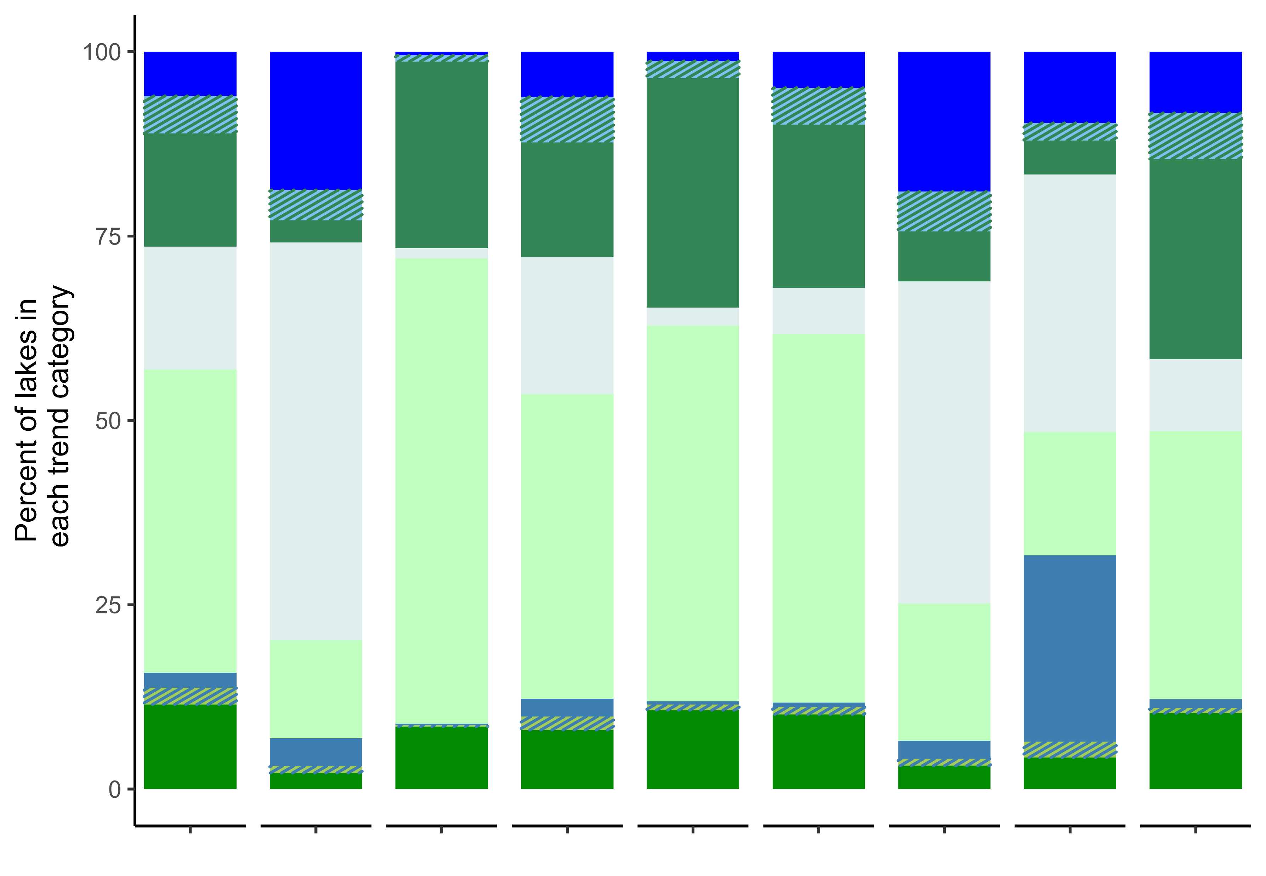
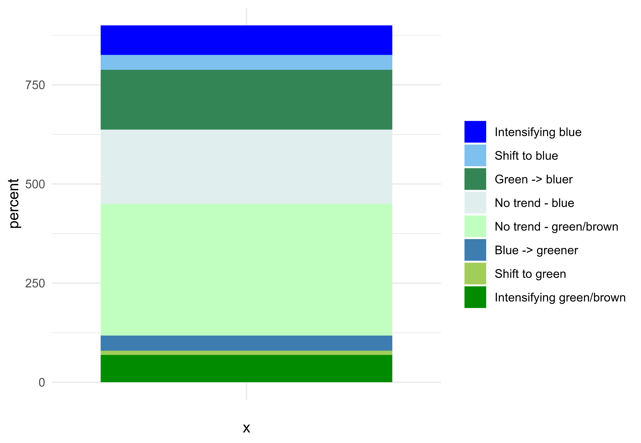


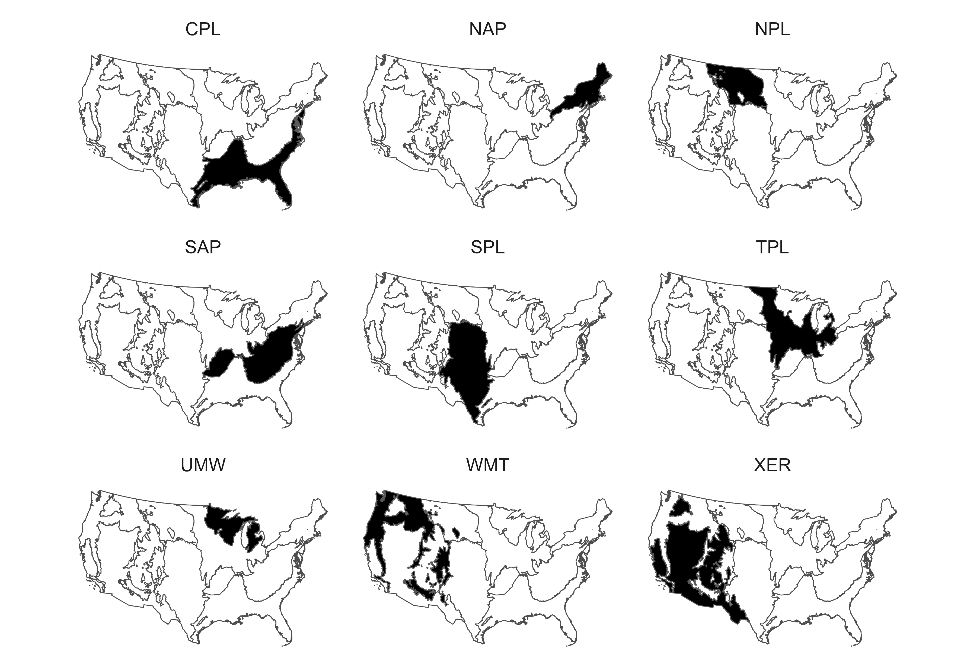


Negative trend
Positive trend
Coastal Plains
Northern Plains
Southern Appalachians
Southern Plains
Temperate Plains
Upper Midwest
Western Mountains
Xeric
Northern Appalachians

Slide 2
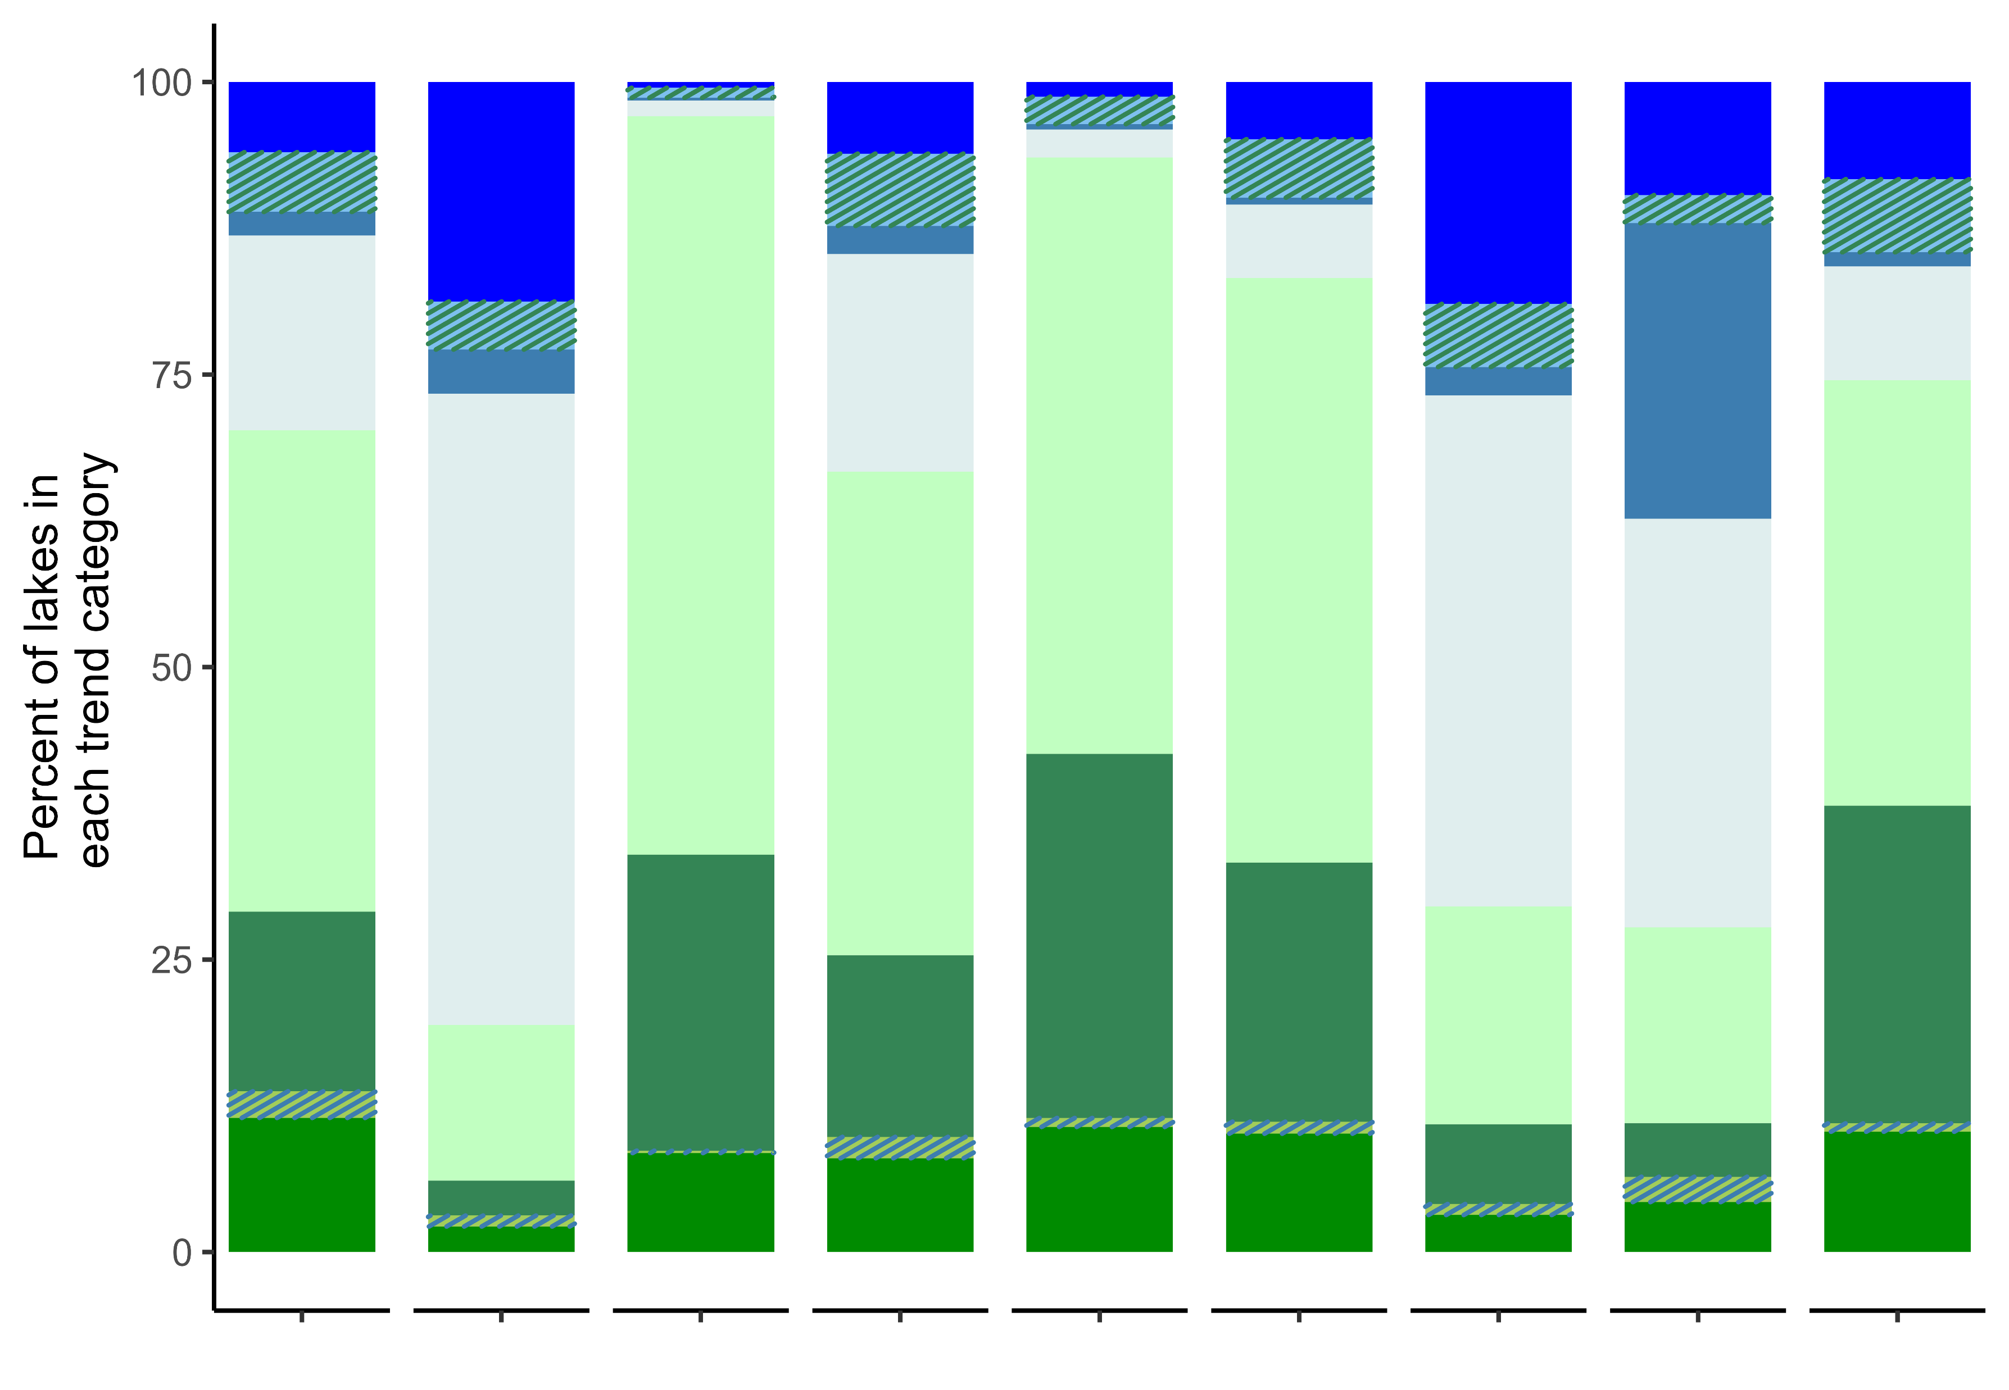
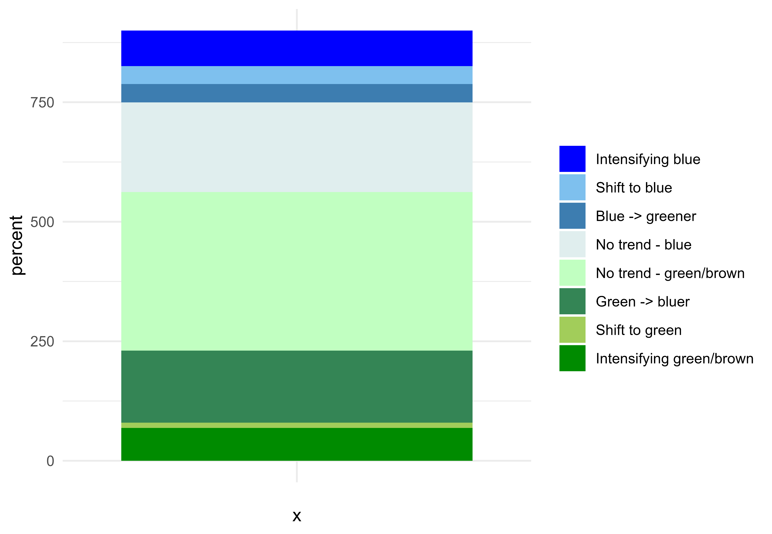
Coastal Plains
Northern Plains
Southern Appalachians
Southern Plains
Temperate Plains
Upper Midwest
Western Mountains
Xeric
Northern Appalachians

Slide 3
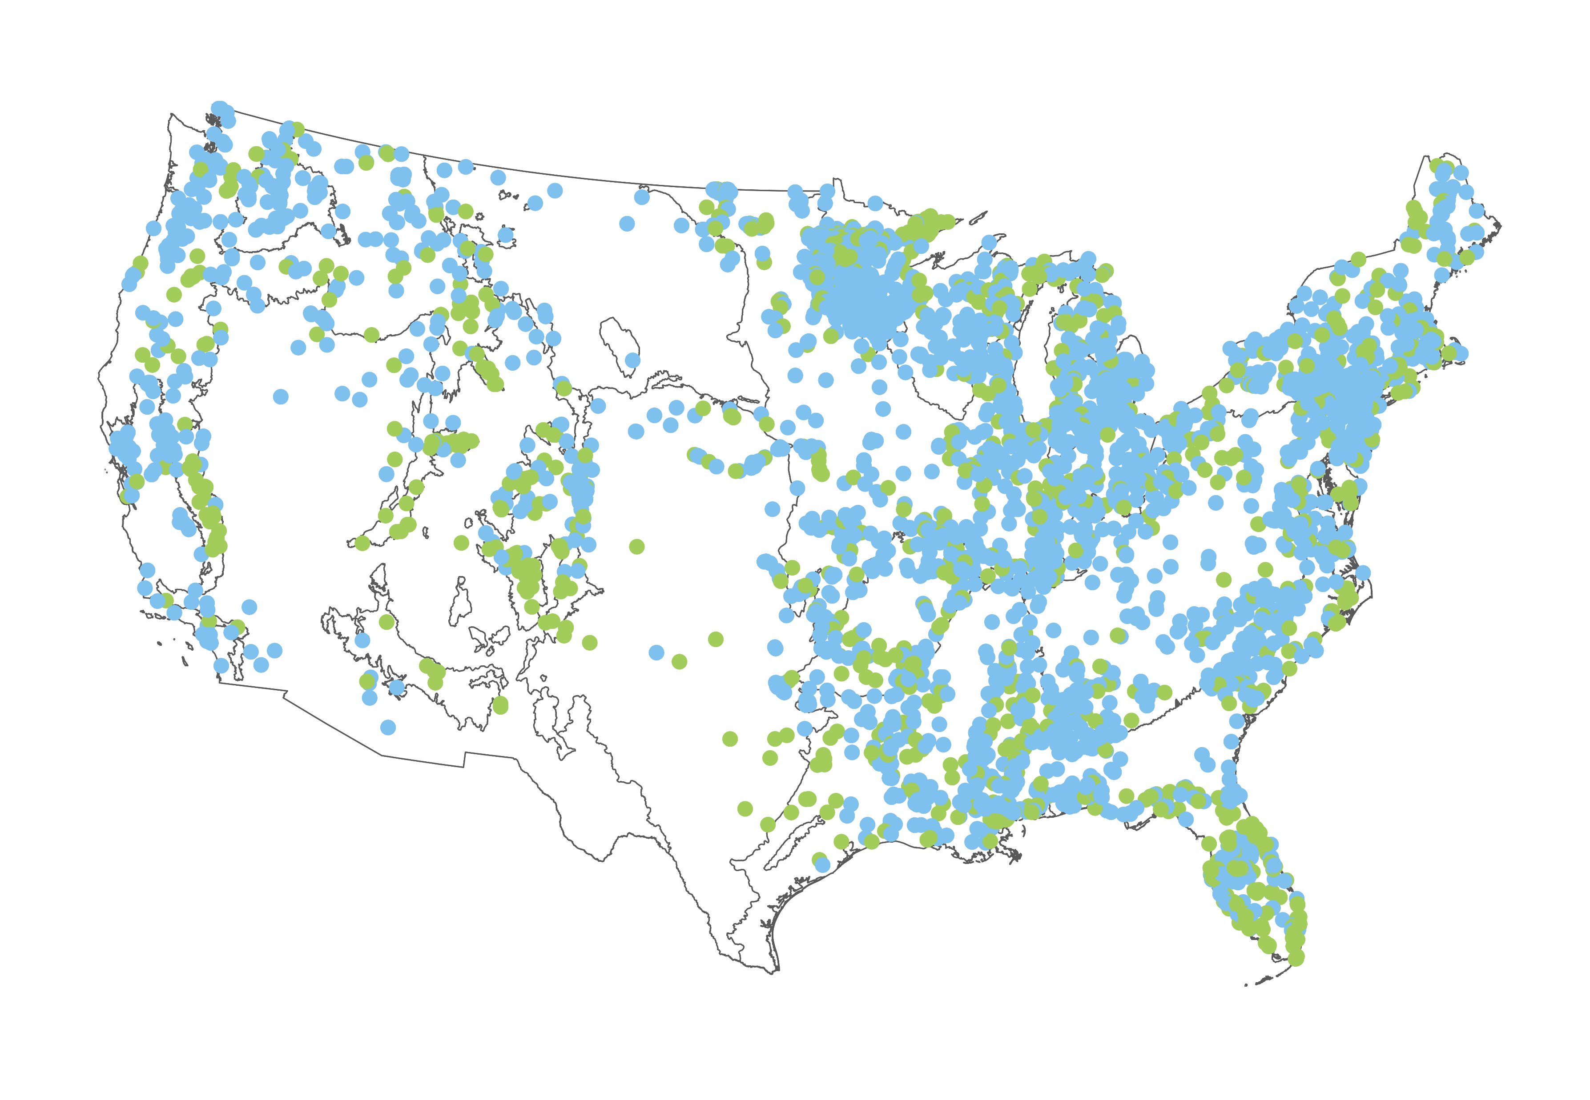
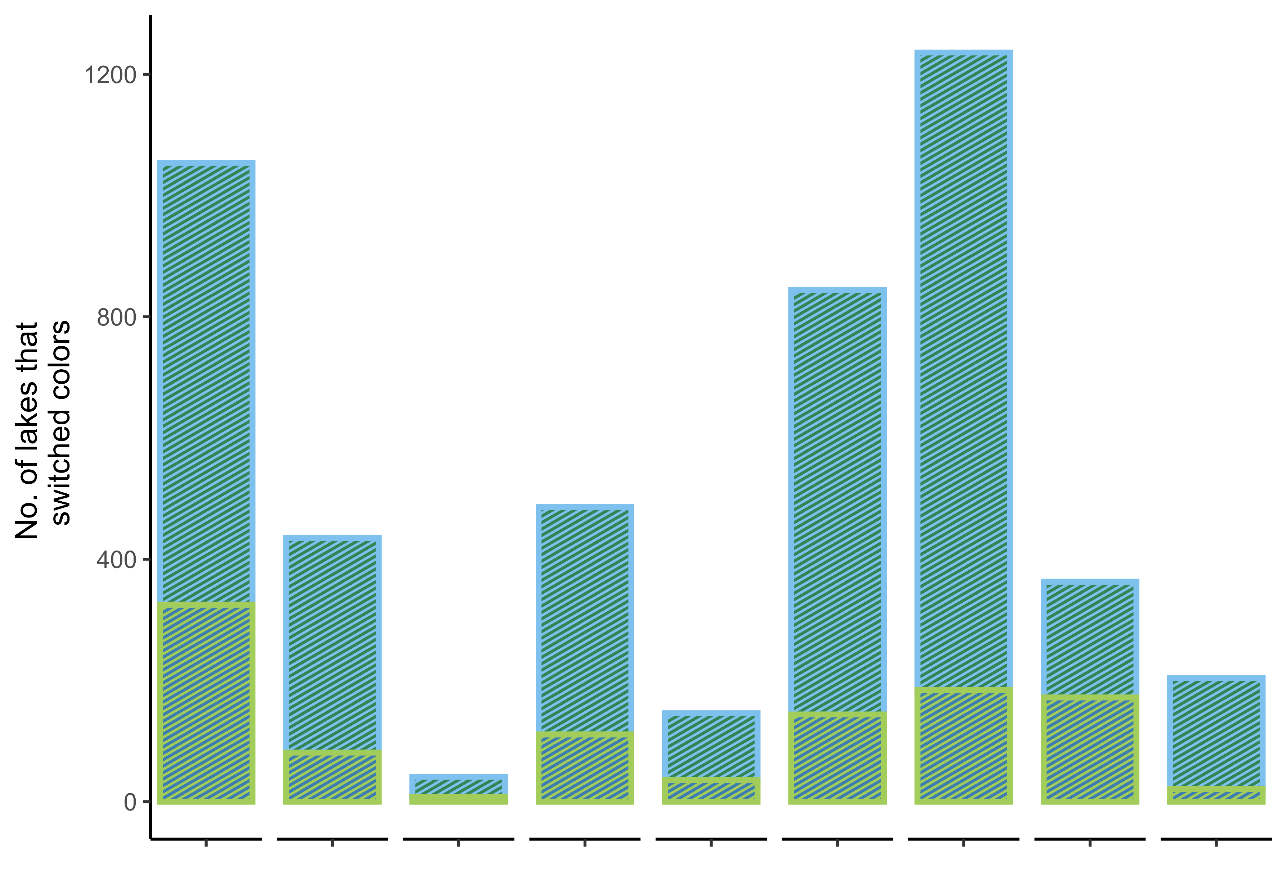
Coastal Plains
Northern Plains
Southern Appalachians
Southern Plains
Temperate Plains
Upper Midwest
Western Mountains
Xeric
Northern Appalachians

Slide 4


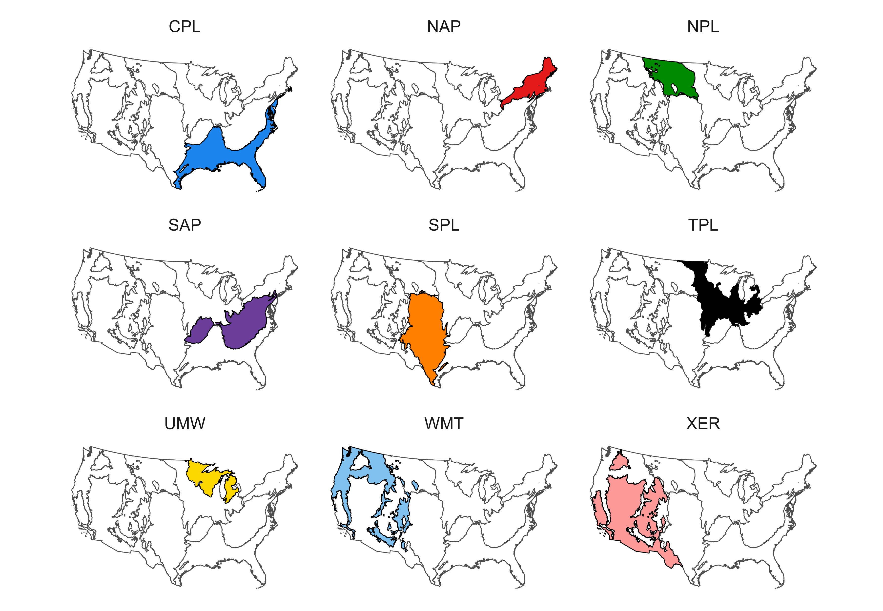

Slide 5
